Slide 1
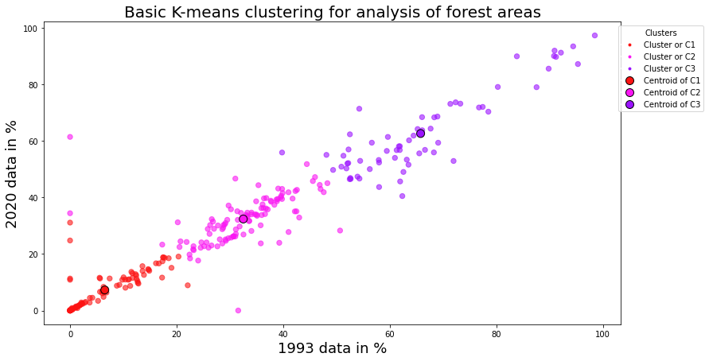
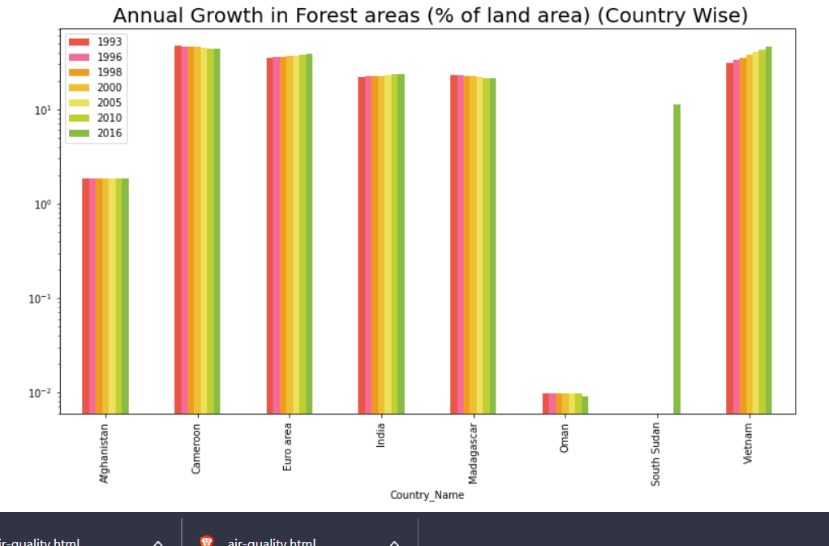
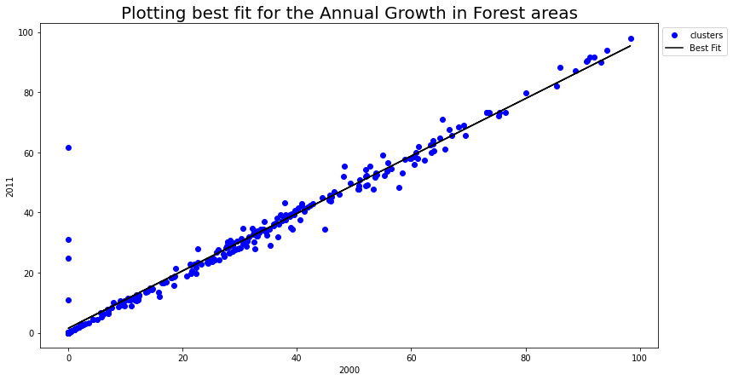
Analysis of the annual growth of forest areas
Executive Summary
Clustering
This graph is a scatter plot that represents the results of a K-means clustering analysis of forest areas. K-means clustering is a type of unsupervised learning where a set of data points is grouped into clusters or subsets. In this case, the data points represent the percentage of forest area in 1993 and 2020. The graph shows the percentage of forest area in 1993 on the x-axis and the percentage of forest area in 2020 on the y-axis.
This report examines the global distribution of forest areas and their growth over time by presenting a graph of the annual growth of forest areas as a percentage of total land area for different countries and performing a K-means clustering and fitting analysis. It provides an insight into the current state of forest cover in different countries and how it has changed since 1993.
Introduction
This report provides an overview of the global distribution of forest areas and their growth over time. It examines the current state of forest cover in different countries and how it has changed since 1993. It also looks at the results of a K-means clustering analysis of forest areas and the plotting of a best-fit line for the annual growth of forest areas. By examining these data points, researchers, policymakers, and conservationists can gain valuable insights into the current state of forest cover in different countries and how it has changed over the years. This report will discuss the results of these analyses and provide recommendations for future conservation efforts.
Annual Forest Area (% of land area)
Fitting
This graph displays the data points of two columns from a dataframe, along with the best fit line. The x-axis is labelled with the name of the column taken as x and the y-axis is labelled with the name of the column taken as y. The data points are shown as blue circles and the best fit line is indicated by a black line. The legend of the graph shows the label for the data points, which is "clusters", and the label for the best fit line, which is "Best Fit".
This graph displays the annual growth of forest areas as a percentage of total land area for different countries from 1993 to 2016. The countries are represented by different colours, and the graph is plotted on a logarithmic scale. The data is represented in the form of bar graphs for each year, and the different colours used for each country make it easier to visually compare the data. The graph provides an insight into the overall growth of forest areas in different countries over the years.
Conclusion
The graph revealed which countries had seen the greatest increase in forest area since 1993 and allowed for a detailed comparison between different countries. The clustering analysis provided insight into the general trend in forest areas over the past few decades, while the fitting analysis gave an estimate of the rate of annual growth in forest areas and the accuracy of the data points.

